Slide 1
First approach : different algorithms for train pictures
BURGUÉS Gerard
ROGIE Elliot

Slide 2
SIFT : Scale Invariant Feature Transform
4 steps:
Constructing a Scale Space
Keypoint Localisation
Orientation Assignment
Keypoint Descriptor
Notes:
https://www.analyticsvidhya.com/blog/2019/10/detailed-guide-powerful-sift-technique-image-matching-python/

Slide 3
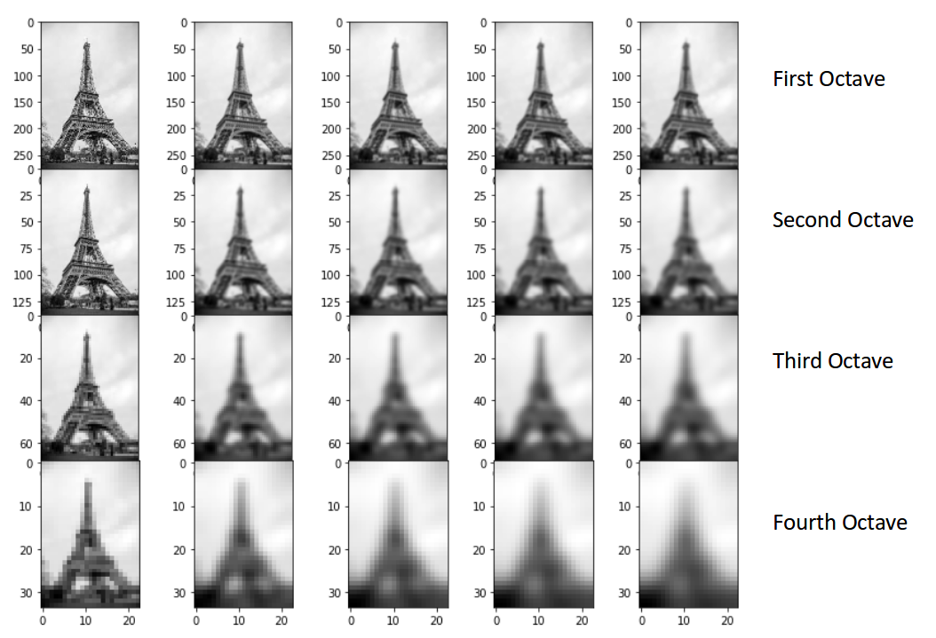
SIFT : Constructing a Scale Space
Divide by 2 the number of pixel (4 time)
Made different level of blur
Use Difference of Gaussian for each octave.
Goal :
Reduce the noise of the picture
Unscale picture

Slide 4
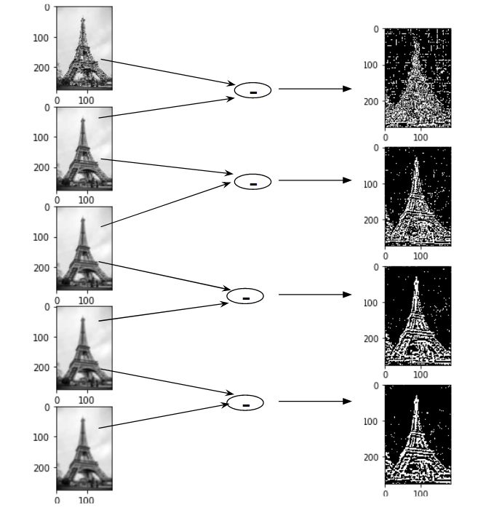
SIFT : Constructing a Scale Space

Slide 5
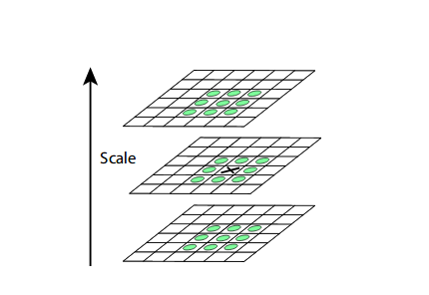
SIFT : Keypoint Localisation
Select extreme contrast point between the 26 pixels around a point (8 point for the picture analysed and 18 for the picture of the octave
Second selection with two tests : low contrast and border
Notes:
a second-order Taylor expansion is computed for each keypoint (test low contrast)
Border : eliminate keypoint if there are to close to the picture border

Slide 6
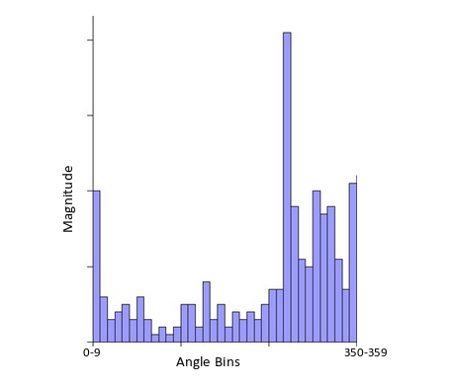
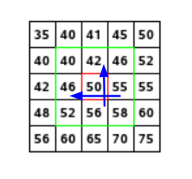
SIFT : Orientation Assignment
For each keypoint, we calculate different the magnitude and the angle.
Made a histogram of all vector of the pixel around the keypoint and the vector of the key point depend of this histogram (show the peak
Notes:
Magnitude = √[(G_{x})²+(G_{y})²]
Φ = atan(Gy / Gx)
I dont understand what is the histogram

Slide 7
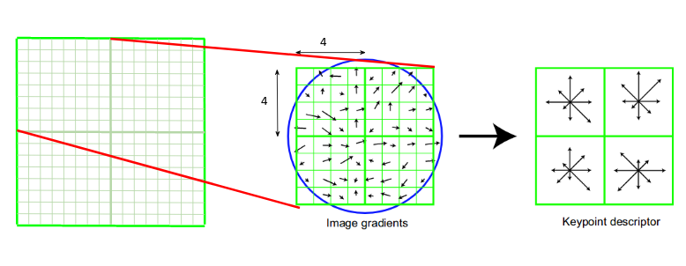
SIFT : Keypoint Descriptor
For each key point make a fingerprint. That mean to have information of the neighbour direction and magnitude

Slide 8
LBPH (Local Binary Patterns Histograms) face recognizer
Condition of working :
Only face pictures (so face detection is already done)
Same size
3 steps:
LBP operations
Extracting histogram
Histogram Compare
Notes:
https://towardsdatascience.com/face-recognition-how-lbph-works-90ec258c3d6b

Slide 9
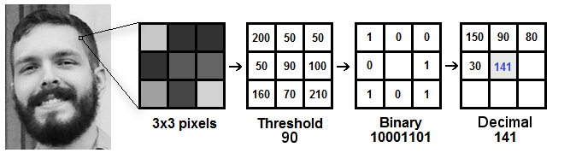
LBPH : LBP operations
Transform the picture to see easily highlighting the facial characteristics .
Choose the radius and the number of neighbour
Transform the neighbour into binary (if the intensity is < of the point put 0 else put 1)

Slide 10
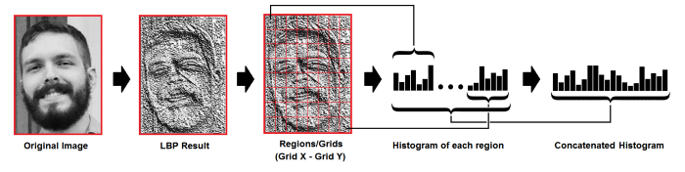
LBPH : Extracting histogram
Divide the picture by grid
For each grid, make an histogram with the occurrence of difference intensity.
Concatenate all histogram

Slide 11
LBPH : Histogram
In this step, you have plenty of histogram (depends of the train data)
With a test picture:
Make the histogram
Find the closest histogram with train data
euclidean distance, chi-square, absolute value methods

Slide 12
Thank you for your atention

